Slide 1
Recursion Modules
Built-in and User-defined Modules

Slide 2
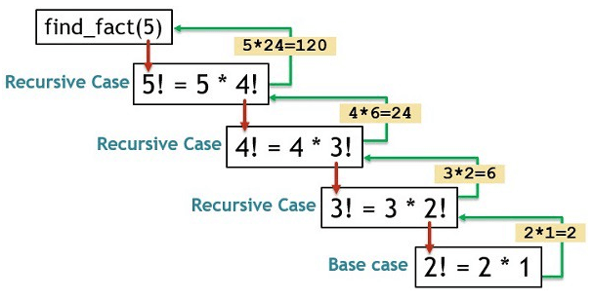
Recursion
Recursion is a process where a function calls itself.
Each recursive call should bring the problem closer to a base case.
Base Case: The condition under which recursion stops.
Recursive Case: The part of the function that calls itself.

Slide 3
Example: Factorial Using Recursion
def factorial(n):
if n == 0 or n == 1:
return 1
else:
return n * factorial(n-1)
print(factorial(5)) # Output: 120

Slide 4
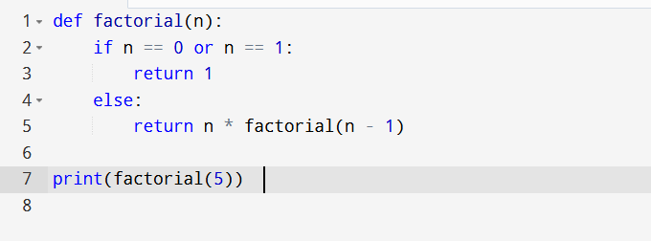
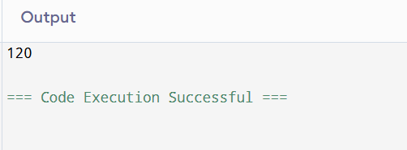

Slide 5
Modules in Python
A module is a file containing Python code (functions, classes, variables).
It allows code reuse and better organization.
Types of modules:
- Built-in Modules
- User-defined Modules

Slide 6
Built-in Modules
Python provides many modules by default.
math: for mathematical functions
random: for random number generation
datetime: for date and time operations
os: for operating system interactions
Example:
import math
print(math.sqrt(25)) # Output: 5.0

Slide 7

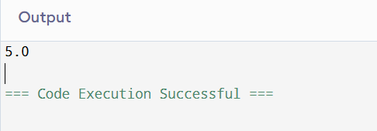

Slide 8
User-defined Modules
A user-defined module is created by the programmer.
Example:
# mymodule.py
def greet(name):
return f'Hello, {name}!'
# main.py
import mymodule
print(mymodule.greet('Alice'))

Slide 9
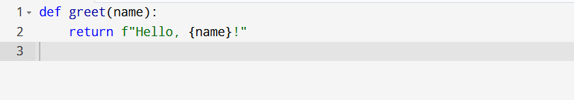
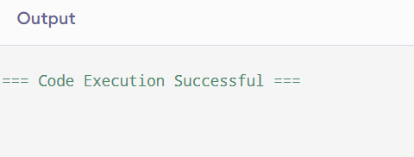

Slide 10
Summary
Recursion allows solving problems by calling the same function.
Modules organize code into reusable components.
Built-in modules provide ready-to-use functionalities.
User-defined modules enhance modular programming.

